Slide 1
Background Services
In .NET
Doing the Real Work™ that no one sees.

Slide 2
Who is this guy?
Notes:
Just a guy.
Written hundreds of background services in .NET.

Slide 3
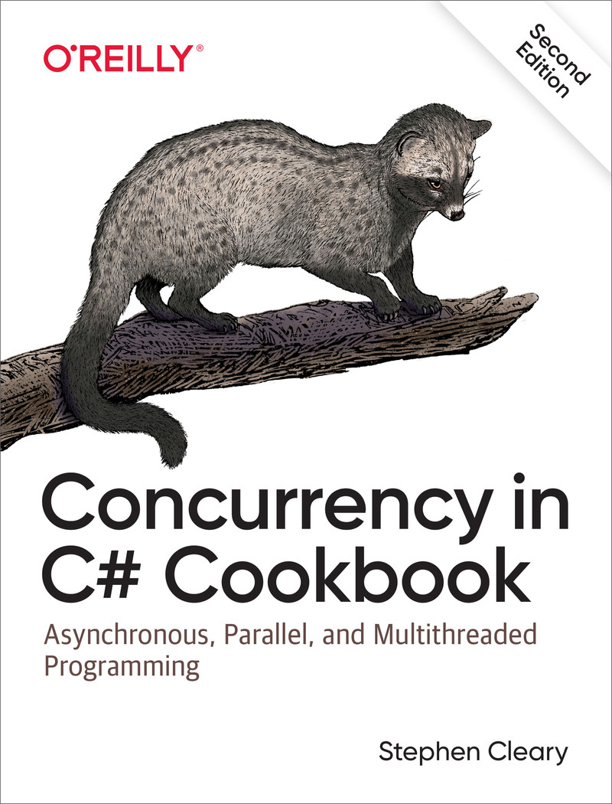

Slide 4
“Background Service”?

Slide 5
“Background Service” (for this talk)
Some piece of code that runs on the backend
The backend of the backend.
Common examples: queue processor, scheduled job
Tend to run in Docker containers, on VMs, or on on-prem hardware.
Non-examples: could-native queue processors
Azure Function / AWS Lambda / Google Cloud Function
These provide their own hosting system.
Non-examples: Mobile/StoreApp "background jobs“
iOS Background Tasks / Android Task Scheduling / UWP Background Tasks
Again, a different custom hosting situation.
Notes:
If you want to leave now, I wouldn’t blame you!
I mention hosting a couple times in this slide, so let’s talk about hosting!

Slide 6
Hosting! And hosting…
Process host
Console (incl Docker), Win32 service, systemd, ASP.NET, UI
.NET (Generic) Host
BackgroundService, IHostedService

Slide 7
Process Hosts

Slide 8

Process Hosts: Docker
Use Linux Docker containers.
It’s a Console app! Done.
If you use Windows Docker containers:
Why do you hate yourself?
Pre-6.0 containers don’t support clean shutdowns out of the box: https://stackoverflow.com/questions/60517716/can-a-net-core-application-on-windows-trap-a-sigterm-event

Slide 9
Process Hosts: Win32 Services
Reliability flag: https://blog.stephencleary.com/2020/06/servicebase-gotcha-recovery-actions.html
Working directory is not where your exe/dll is. https://blog.stephencleary.com/2009/10/managed-windows-services-basics.html
No redirected network drives; use UNC paths instead. https://blog.stephencleary.com/2009/10/windows-services-and-network.html

Slide 10
Process Hosts: systemd daemons
Don't use default working directory! https://github.com/dotnet/runtime/issues/113855
Actually causes a stack overflow exception. Fun!

Slide 11
Process Hosts: ASP.NET and UI
ASP.NET hosts are well-documented and thus not considered important enough to be covered much in this talk. There’s a fun example of terrible code coming later, though! https://learn.microsoft.com/en-us/aspnet/core/fundamentals/host/hosted-services
UI hosts are trickier. https://github.com/StephenCleary/Hosting currently supports WPF (WinForms is possible).

Slide 12
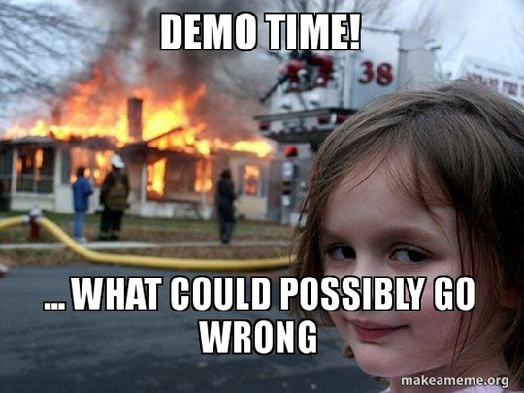
Notes:
Basic app running as Win32 service, systemd service, Console in docker.
(Taking shortcuts for the demo; normally you'd dotnet-publish and then copy those files in, set the entrypoint, and build the image)

Slide 13
Notes:
Adding background worker to existing ASP.NET app.

Slide 14
.NET Host

Slide 15
.NET Host: Host Lifetime
Working around a poor design:
https://blog.stephencleary.com/2020/06/backgroundservice-gotcha-application-lifetime.html
Super details!
https://andrewlock.net/introducing-ihostlifetime-and-untangling-the-generic-host-startup-interactions/

Slide 16

.NET Host: Host Startup
Synchronous starts: https://blog.stephencleary.com/2020/05/backgroundservice-gotcha-startup.html
Most common: synchronously reading from a queue as the first real work in a worker.

Slide 17
.NET Host: Silent Failures
(pre-6.0 only): https://blog.stephencleary.com/2020/05/backgroundservice-gotcha-silent-failure.html

Slide 18
Notes:
FixedBackgroundServiceEx2

Slide 19
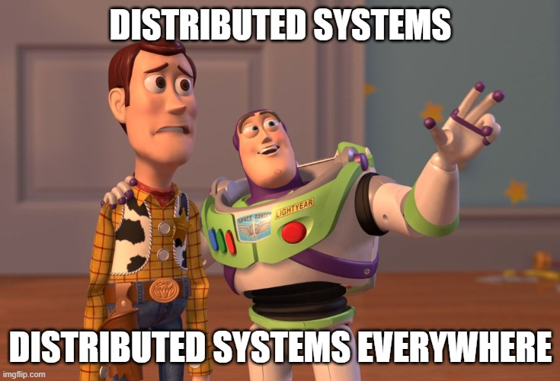
Distributed Background Services

Slide 20
Allow Shutdowns
This sounds stupid, but it’s super easy to get wrong!
Including rolling upgrades!
Key point: no in-memory queues!
https://blog.stephencleary.com/2021/01/asynchronous-messaging-2-durable-queues.html
Yes, this popular MS example code is completely unsuitable for production! https://learn.microsoft.com/en-us/dotnet/core/extensions/queue-service

Slide 21
Allow Multiple Instances
Generally not a problem for queue consumers (since messages can be delivered out-of-order anyway… you knew that, right?)
For scheduled jobs that really should only be run by one instance, use a distributed lease.
Fairly easy to build on CosmosDB / DynamoDB / Redis.
https://gist.github.com/StephenCleary/9777f2dcb9834a05efb261cc36839b3c

Slide 22
Common Patterns

Slide 23
Common Patterns
CriticalServiceBase (already demo’d)
Logging:
Logging format may change per host. Consider JSON one-line-per-message for Docker.
Logging scopes!
Logging exception scopes! https://github.com/StephenCleary/Logging
Dependency Injection
Provide your own scopes: https://learn.microsoft.com/en-us/dotnet/core/extensions/scoped-service

Slide 24
Notes:
Queue consumer example (with local queue)
Scheduled job example (with leases)

Slide 25
Q&A

